Slide 1
FINAL PROJECT

Slide 2
AGENDA
Idea of the Website
My website
Color and Fonts
What I’ve learned
Difficulties
Possible improvements

Slide 3
IDEA OF THE WEBSITE

Slide 4



why I chose it
Main reasons:
Covers front-end basics: HTML (structure), CSS (design) and JavaScript (behavior)
Is a scalable project: can start small and expand (therefore learning in a gradual way)
Portfolio value: is a professional-looking project

Slide 5
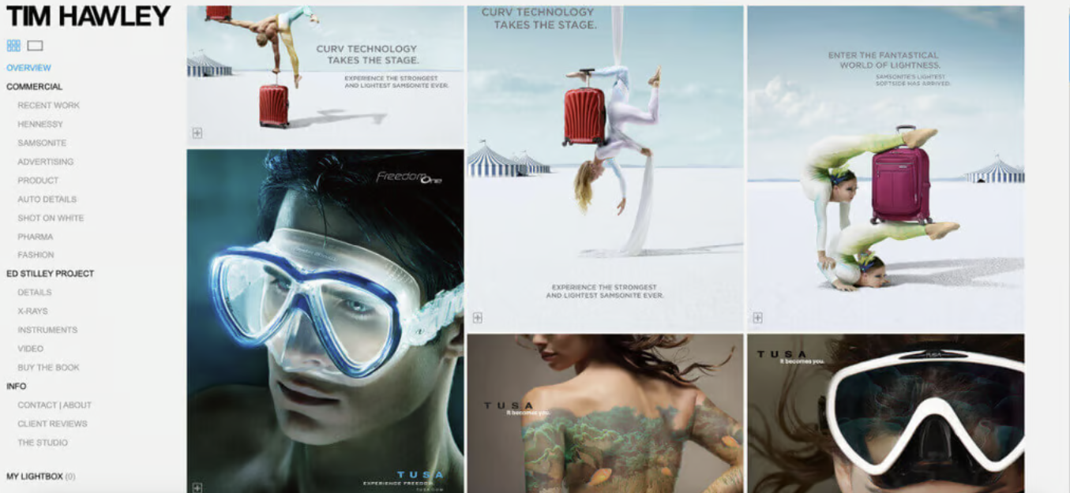
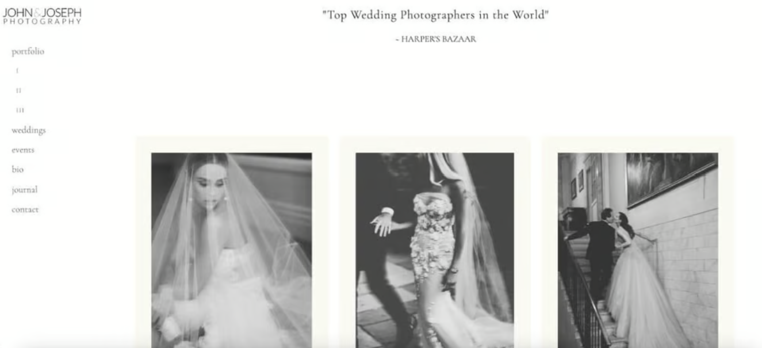
What was the idea
TIM HAWLEY:
My first idea:
A photography website inspired by modern portfolio designs
Fixed left vertical menu
Gallery
About
Contact
JOHN&JOSEPH:
Notes:
Gallery – photos displayed in a grid, with hover effects and an enlarged view when clicked.

Slide 6
My website

Slide 7
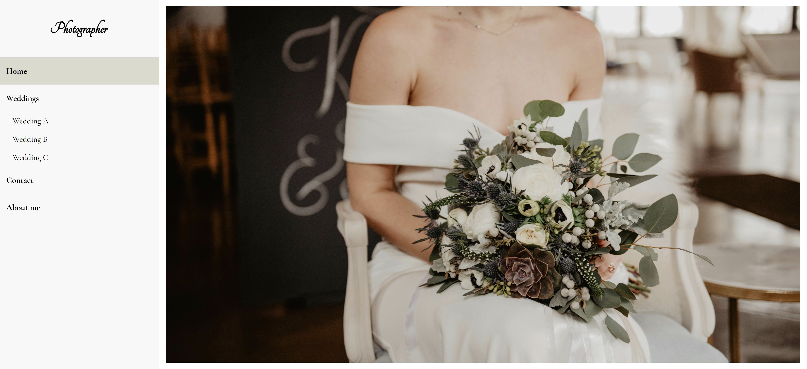
My website

Slide 8

Colors and fonts

Slide 9
Choosing colors and fonts
Colors
Fonts:
I choose the colors: black, white and beige/gray
Elegance
Simple
Sofisticated
I choose 2 fonts:
Tangerine: more design & elegant
For the titles and for the “logo”
Cormorant Garamond: simple & easy to read
For the menu and content
Menu
H2
Photo Row
Footer

Slide 10

What I’VE learned

Slide 11
What I’VE learned
My learning process:
With the creation of this website, I was able to understand a little bit more about:
CSS Flexbox
LightBox
Contact Page with Formular and JavaScript
Gallery Page via JavaScript
Regex for Formular
Notes:
Flexbox is like a magic organizer for your webpage elements: it automatically arranges them neatly in a row or column and adapts when the screen changes size
A lightbox is like a stage that puts the image in the spotlight while the rest of the page temporarily fades away, letting the user focus on what matters most.
The form includes fields for name, phone, email, and a message. Each field is labeled clearly, and required fields ensure users provide essential information.
JavaScript handles form submission. For example, it can capture the data, validate inputs, and show a confirmation message without reloading the page, making the experience smoother for users.

Slide 12
difficulties
Creating my first formular
CSS
Gallery and LightBox
REGEX
JAVASCRIPT
HTML
FLEXBOX
DESIGN
JAVASCRIPT

Slide 13

Going further…
For next steps:
Better regex validation
Simple Mail Transfer Protocol (SMTP)
Elaborated gallery effects
Better design “about me” page
Smoother photo transitions
Improve captions and add to all photos
Improve performance
Media queries responsive

Slide 14
THANK YOU
Talissa Jonen
jonet1@bfh.ch

